Slide 1
SPEECH RECOGNITION FOR STAMMERS
Muhammad Shawaiz Ishtiaq (01-134212-128) Muhammad faizan khan(01-134212-110)

Slide 2
WHAT IS STUTTERING? & OUR PROJECT AIM
1) Our project aims to develop a tool that uses speech recognition to transcribe audio and identify stuttered words.
2) This tool can help analyze speech patterns and provide insights for speech therapy.
3) Stuttering involves repeating words or sounds, making speech recognition challenging.
4) Traditional speech recognition systems struggle to accurately transcribe stuttered speech

Slide 3
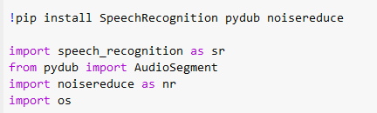
Libraries Used
1) SpeechRecognition:
Purpose: Convert spoken language into written text.
Reason: The SpeechRecognition library provides a simple interface to Google Web Speech API, ensuring accurate transcription.
2) pydub:
Purpose: Handle audio file manipulation, such as conversion between formats.
Reason: pydub offers a straightforward way to convert MP3 files to WAV format.
3) Noisereduce:
Purpose: Reduce background noise in audio files.
Reason: Cleaner audio improves the accuracy of speech recognition.

Slide 4
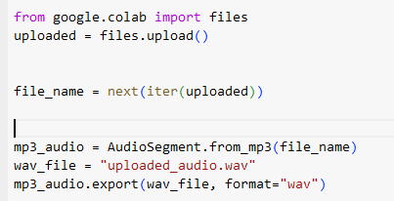
UPLOADING AUDIO FILE (DATASET)
We use Google Colab's files.upload() function to allow users to upload their audio files.
Converting to WAV:
The uploaded MP3 file is converted to WAV format using pydub for compatibility with the SpeechRecognition library.

Slide 5
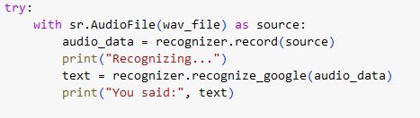
Speech Recognition and Stammer Detection
Using the recognizer object from SpeechRecognition, we load and transcribe the audio content.

Slide 6
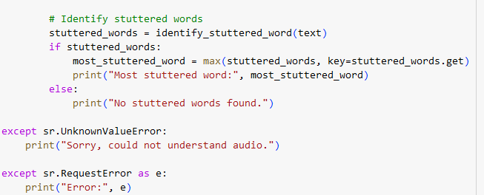
Identifying Stuttered Words

Slide 7
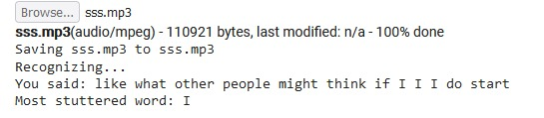
OUTPUT
The dataset audio file contained stuttering audio of a child saying like what other people think if I do stutter. The word I was where he stuttered 3 times.

Slide 8
THANKYOU!

